Slide 1
Quality of Life Indicator Analysis

Slide 2
Methodology
Fix time window
Aggregate crimes before / during/ after
Statistical analysis &
data visualization
A QOL Indicator
Create Date - T
Create Date
T
Closed Date
Closed Date + T
Time
Number of Crimes
Number of Crimes
Number of Crimes
Comparison (Mean / 95% CI)

Slide 3
Result (yellow – significant)
 |  |  | Zip Code - 70117 |  |  |  | Zip Code - 70119
Quality of Life Indicators | Frequency | Beat | 5G02 | 8F04 | 5G01 | 5E01 | 5K02 | 1I03 | 1K01 | 1C02
 |  | Crime Num | 79 | 73 | 59 | 58 | 80 | 60 | 50 | 47
Code Enforcement General Request | 4967
Trash/Garbage Pickup | 3989
Abandoned Vehicle Reporting/Removal | 3388
Residential Recycling Programs | 3256
Street Light | 2245
Large Item Trash/Garbage Pickup | 2163
Illegal Dumping Reporting | 1480
Pothole/Roadway Surface Repair | 703
Rodent Complaint | 638
Tree Service | 507
Street Flooding/Drainage | 457

Slide 4
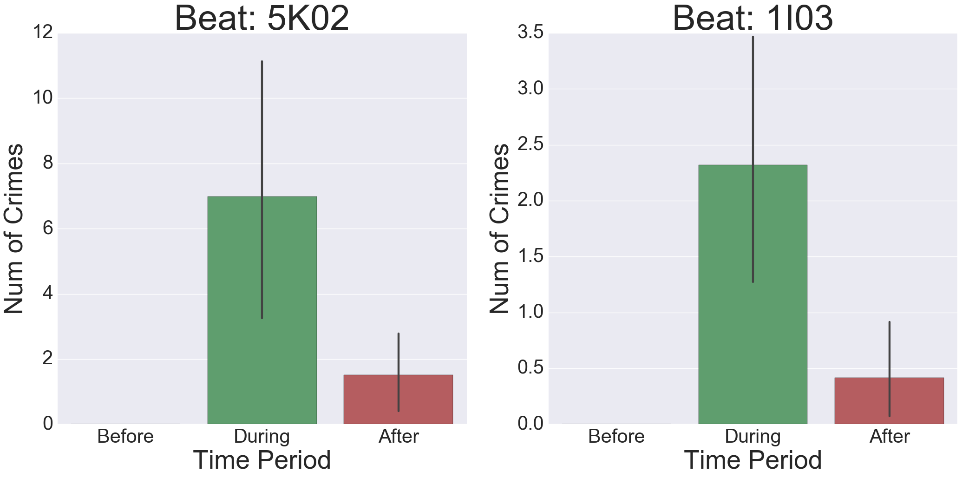
Analysis by indicators
- Abandoned Vehicle Reporting/Removal
Reasons for abandonment - related to crimes
Shelter for illegal activities

Slide 5
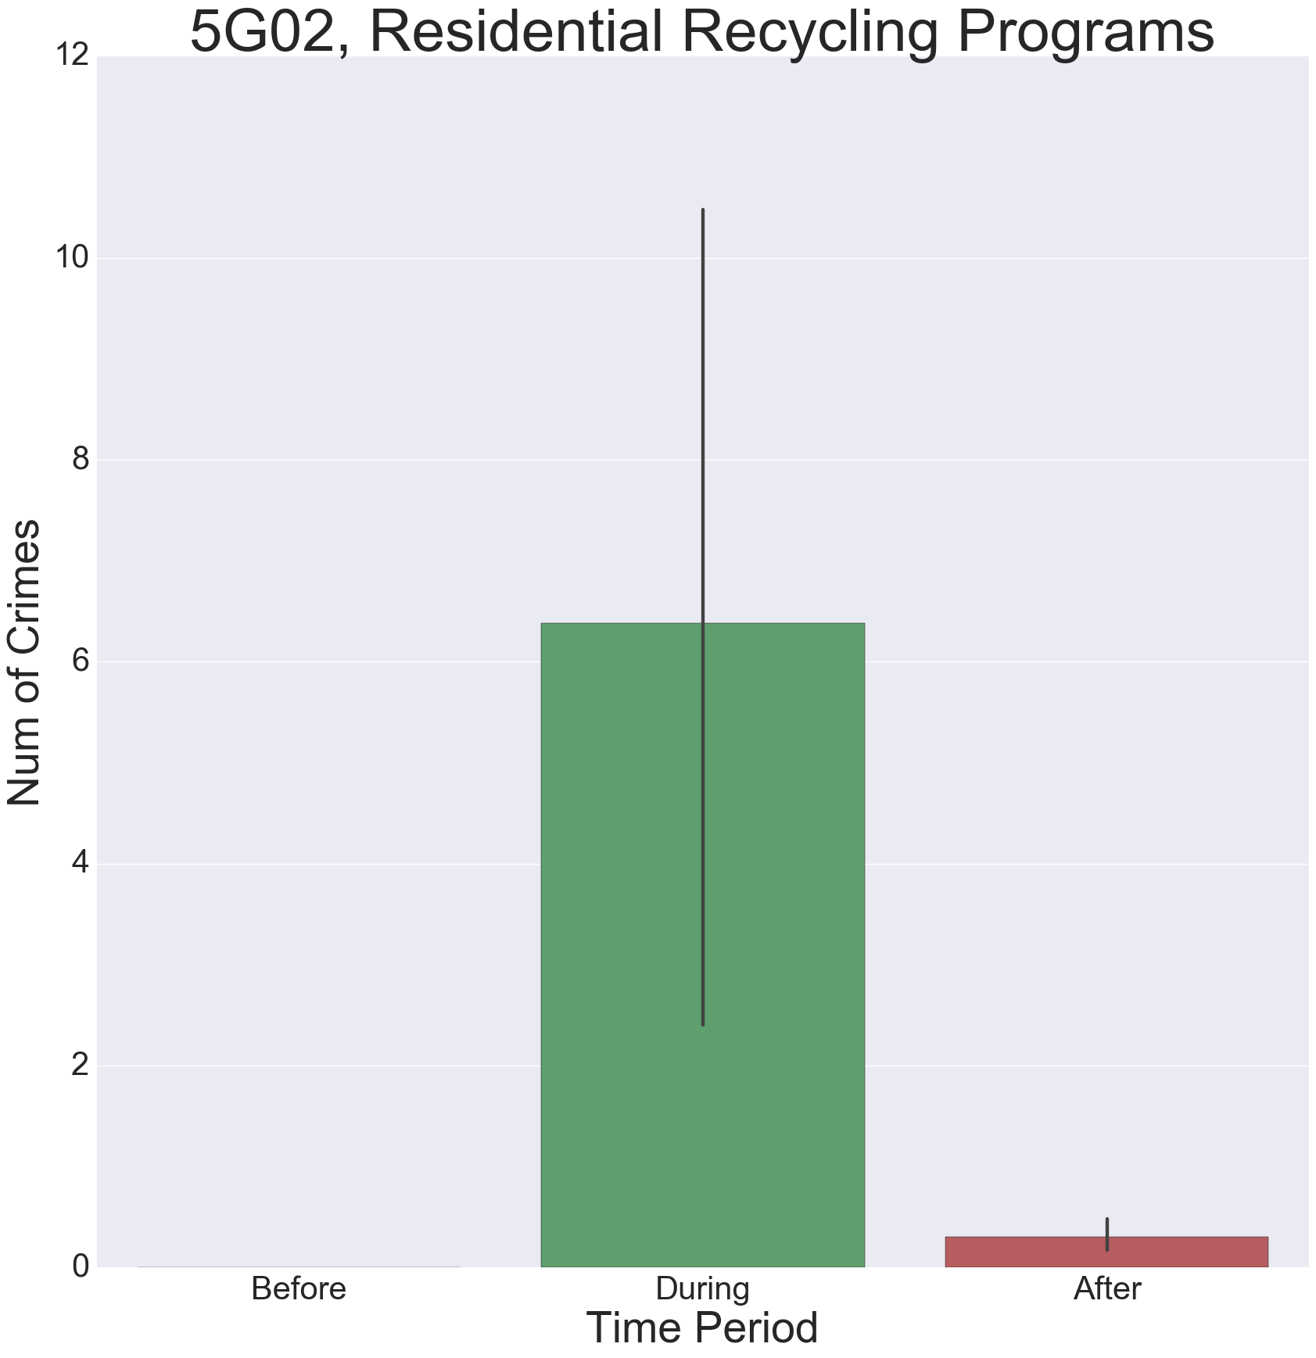
Analysis by beats
Residents might have some specific reasons for not recycles
Garbage related to illegal activities
Frequent change of tenements
Few people live and walk, sheltering crimes

Slide 6
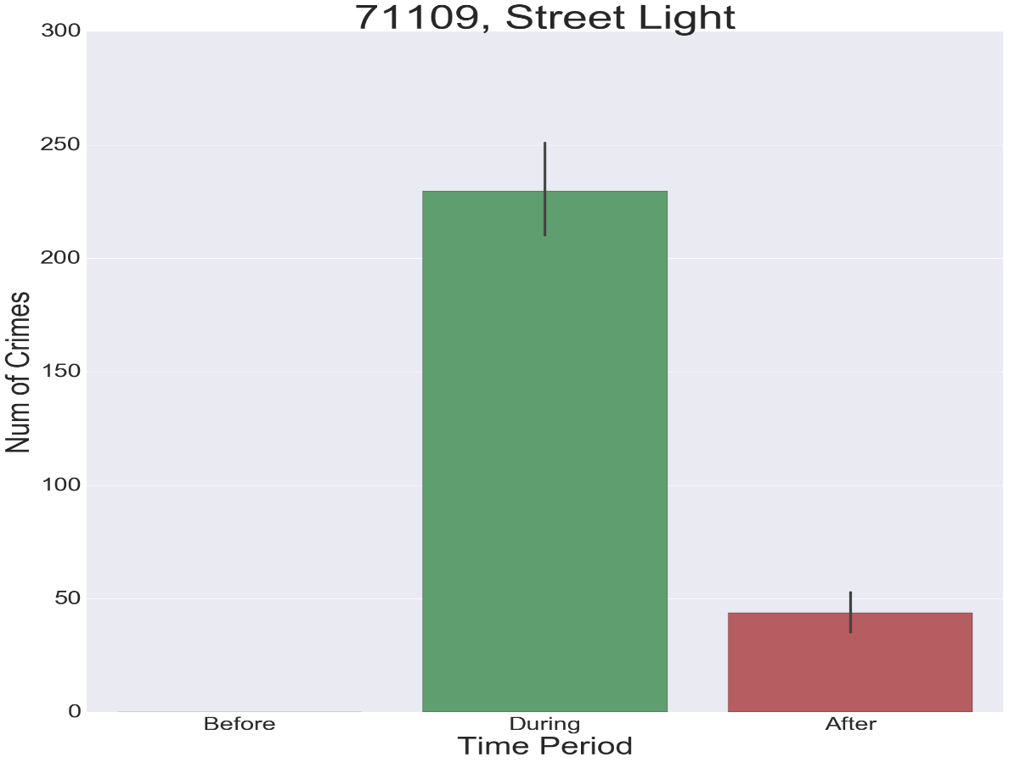
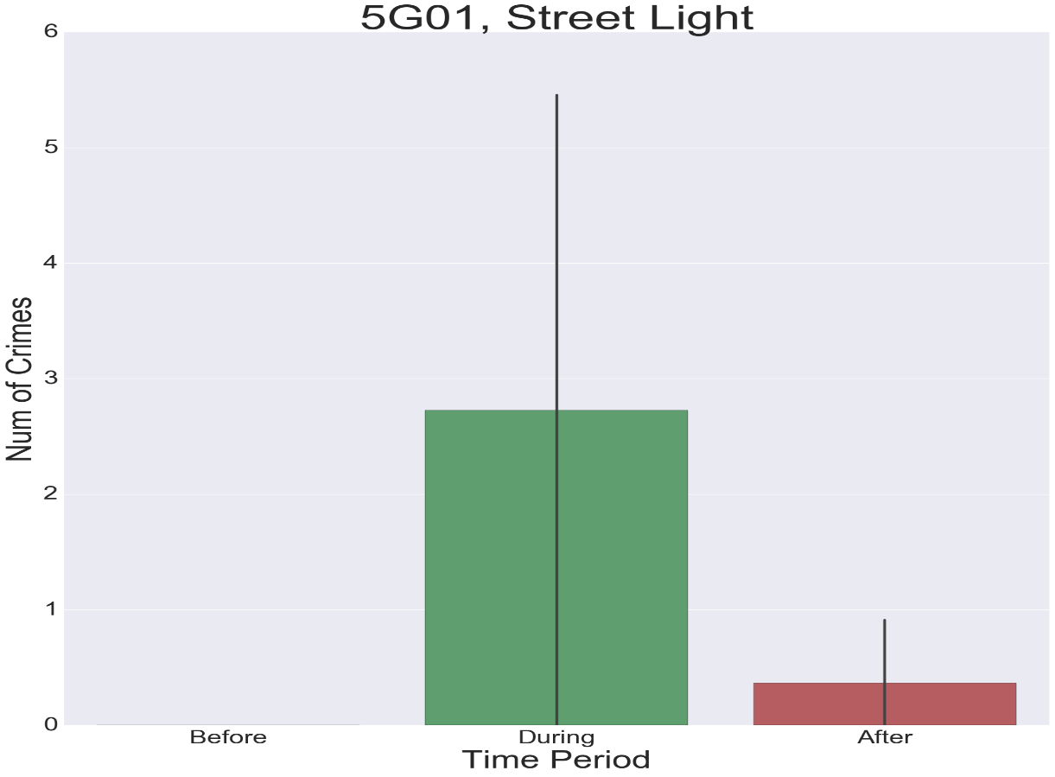
Beats v.s. Zip Code Analysis
- Street lights
Sample size
Varying pattern among beats

Slide 7
Findings & Recommendations & Limitations
1. Findings -
(1) Some quality of life indicator closely related to violence crimes. Especially, when or after these issues happened, the crimes will increase;
(2) The relationship between indicators and crimes vary among beats and between beats and their corresponding area (defined by zip codes).
2. Recommendations -
(1) 5G02 - Residential Recycling Programs
(2) 5G01 - Code Enforcement General Request
(3) 5K02 - Trash/Garbage Pickup & Abandoned Vehicle Reporting/Removal
(4) I103 - Abandoned Vehicle Reporting/Removal & Street Flooding/Drainage
3. Limitations -
(1) Univariate analysis without measuring effect sizes
(2) Small sample size
(2) Differences in time windows

